Slide 1

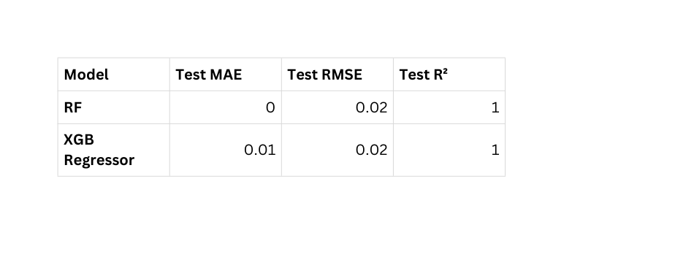
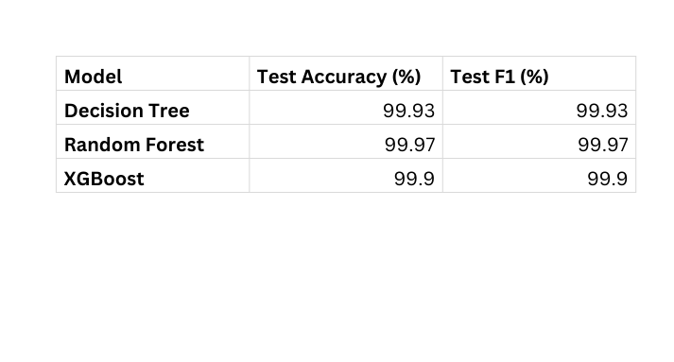
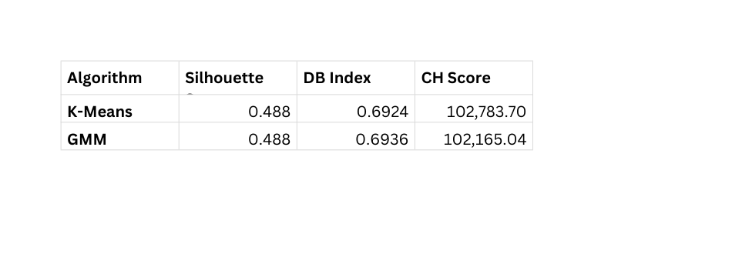
Multi-Factor Health Risk Assessment for Newborns and Adolescents
Vishvapavani Bhupathi, Sai Annessha Veluri, Sai Aravind Nelluri
Masters in Data Science
University of Colorado, Boulder
PROBLEM STATEMENT
Unlabelled Data
Results: Clustering
This project analyzes social and clinical data to assess newborn health risks, using models to identify risk levels and key factors. A semi-supervised modelling approach has been implemented to achieve the goal of multi-health risk index.
Data Cleaning & Processing
Clustering: K-Means,GMM
Results: Classification
DATASET DESCRIPTION
Classification
Logistic Regression,Decision Trees, RF,SVM,KNN,XGBoost,MLP Neural Network
  Dataset contains medical, demographic, and clinical factors for newborns and adolescents.
  It has 62,714 rows × 28 features, mixing numerical and categorical data, with no missing values after cleaning.
  Key feature groups include birth factors, adolescent health indicators, parental/environmental factors.
  Used to train 3-label classification (Low Risk, Medium Risk and High Risk) combined Risk Index.
Results: Regression
Regression
Linear Regression, Ridge Regression, Lasso Regression, Decision Tree,RF,Support Vector Regressor,KNN,XGBoost Regressor,MLP Neural Network
CONCLUSION
For clustering, K-Means performs best with overall validity scores. For classification, the RF model achieves the highest accuracy at 99.97%. For regression, both RF and XGBoost Regressor deliver top performance with an R² of 1.00.
Performance Evaluation

